Slide 3
cddcdf
205,220,223
0e255b
14,37,91
7030a0
112,48,160
d0ac11
208,172,17
4d6a33
77,106,51
1173a0
17,115,160
336b50
51,107,80
c1d5a1
193,213,161

Slide 5
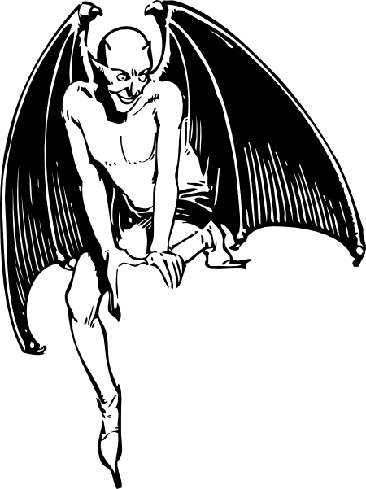
And Satan came also…

